Slide 1

اجتماع قادة الفرق والمساعدين
اللقاء الأول الذي يجمع قادة الفرق والمساعدين في مجالس مجموعة شقائق الخنساء الإرشادية لعام 2025
12.4.2025

Slide 2
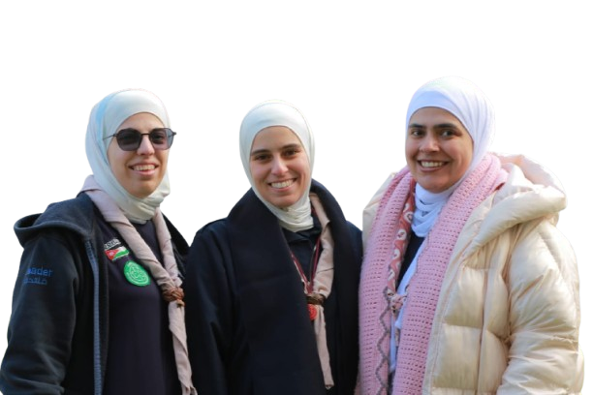
محاور اللقاء:
  - تربوي على الخفيف : قائد عهود
  - مهام قائد الفرقة: قائد آية
  - تعليمات وملاحظات ادارية: قائد فتحية

Slide 3
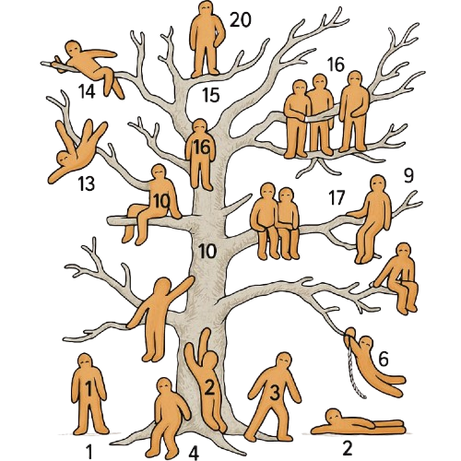
وين بتشوفي حالك كقائد فرقة؟

Slide 4
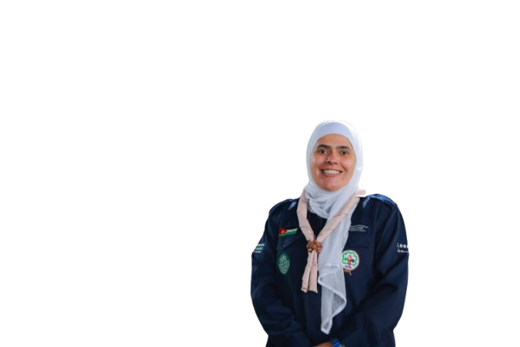
"جبل الرماة"

Slide 5
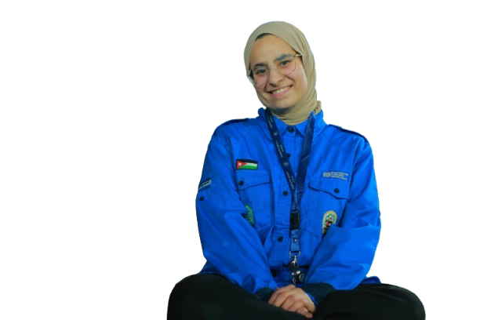
مين هي قائد الفرقة؟
هي القائد التي تأتي في المرتبة الثالثة بعد قائد المجلس ومساعد قائد المجلس

Slide 6
مهام قائد الفرقة
التنسيق مع القيادة العليا
الإشراف المباشر على الأفراد
القيادة الميدانية
تنفيذ الخطط الميدانية
تحدي الفرق
القدوة الحسنة
رفع التقارير والمتابعة
الحضور والغياب

Slide 7
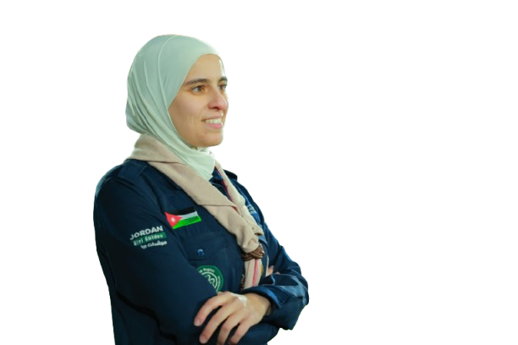
أذكار الصباح مع قائد فتحية

Slide 8
01
03
02
04
تعليمات هامة
تبني قرارات المجموعة
عدم تناقل المعلومات
الالتزام بكامل التعليمات
الحرص على صورة المجموعة

Slide 9
2nd Announcement
FIELD TRIP TO THE FOREST
CAMPING
SURVIVAL COURSE
Jupiter is the
biggest planet in our Solar
System and also the
fourth-brightest object in
the sky
Neptune is the farthest
planet from the Sun, the
fourth-largest in our Solar
System and also the
densest
Despite being red, Mars is
actually a cold place. It’s
full of iron oxide dust,
which gives the planet its
reddish cast

Slide 10
In Depth
COMMITTED TO SPORT
GAMES FOR DEVELOPMENT
Jupiter is the
biggest planet in our Solar
System and also the
fourth-brightest object in
the sky
Neptune is the farthest
planet from the Sun, the
fourth-largest in our Solar
System and also the
densest

Slide 11
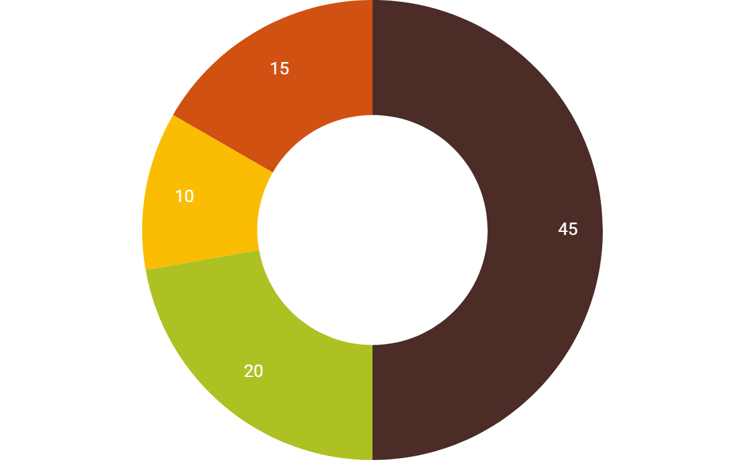
In Depth
Mercury
Camping
Expedition
Trip to the River
Summer Games
Mercury is the closest planet to the Sun
and the smallest one in the Solar
System—it’s only a bit larger than our
Moon. The planet’s name has nothing to
do with the liquid metal, since it was
named after the Roman messenger god
If you want to modify this graph, click on it, follow the link, change the data and replace it

Slide 12
Sector News
Mars
01
Venus
02
Despite being red, Mars is actually a cold place. It’s full of iron oxide dust, which gives
the planet its reddish cast
Saturn
Venus has a beautiful name and is the second planet from the Sun. It’s terribly hot, even hotter than Mercury
Mercury
Jupiter

Slide 13
03.
In Brief

Slide 14
News
Neptune
Mars
Mercury
Jupiter
Neptune is the farthest planet from the Sun and
the fourth-largest in our Solar System
Despite being red, Mars is a cold place. It’s full of iron oxide, giving the planet its reddish cast
Mercury is the closest planet to the Sun and also
the smallest one in our Solar System
Jupiter is the biggest planet in our Solar System and the fourth-brightest
object in the sky

Slide 15
Reviews from Kids
“Neptune is the farthest planet from the Sun and the fourth-largest in our Solar System”
“Despite being red, Mars is a cold place. It’s full of iron oxide, giving the planet its reddish cast”
John Smith
(7 years old)
Jenna Smith
(8 years old)

Slide 16
04.
Welcome!

Slide 17
Welcome!
Overnight Camping Supervisor
Venus has a beautiful name
and is the second planet from
the Sun. It’s terribly hot—even
hotter than Mercury—and its
atmosphere is extremely
poisonous

Slide 18
Welcome!
New Aquatic Activities Teacher
Mercury is the closest planet to the Sun and the smallest one in our Solar System—it’s only a bit larger than our Moon. The planet’s name has nothing to do with the liquid metal, since it was named after the Roman messenger god, Mercury

Slide 19
05.
Events

Slide 20
Upcoming Events
Mercury is the closest planet to the Sun
Despite being red, Mars is a cold
place
Venus has a beautiful name, but it’s very hot
Saturn is the ringed planet and a gas giant

Slide 21
Thanks!
Does anyone have any questions?
youremail@freepik.com
+91 620 421 838
yourcompany.com
facebook.com/Freepik
@Freepik_Vectors
company/freepik-company

Slide 22
Alternative Resources

Slide 23
Alternative Icons

Slide 24
Resources
Did you like the resources on this template? Get them for free
at our other websites.
VECTORS
Modern hand drawn 2019 calendar template
People doing outdoor activities
Colorful speech bubbles set
Explorer with backpack background
Adventure label collection
Cute camping equipment in flat design
Explorer with backpack background
World book day background with kids reading
Lovely children's day composition with flat design
Valentine's day medal collection
Colorful school timetable template flat design
ICONS
In The Forest Icon Pack

Slide 25
Instructions for use
In order to use this template, you must credit Slidesgo by keeping the Thanks slide.
You are allowed to:
- Modify this template.
- Use it for both personal and commercial projects.
You are not allowed to:
- Sublicense, sell or rent any of Slidesgo Content (or a modified version of Slidesgo Content).
- Distribute Slidesgo Content unless it has been expressly authorized by Slidesgo.
- Include Slidesgo Content in an online or offline database or file.
- Offer Slidesgo templates (or modified versions of Slidesgo templates) for download.
- Acquire the copyright of Slidesgo Content.
For more information about editing slides, please read our FAQs or visit Slidesgo School:
https://slidesgo.com/faqs and https://slidesgo.com/slidesgo-school

Slide 26
Fonts & colors used
This presentation has been made using the following fonts:
Comfortaa
(https://fonts.google.com/specimen/Comfortaa)
#ffab40
#4b2c27
#d15112
#f8db03

Slide 27
Use our editable graphic resources...
You can easily resize these resources, keeping the quality. To change the color, just ungroup the resource and click on the object you want to change. Then, click on the paint bucket and select the color you want. Don’t forget to group the resource again when you’re done.

Slide 29
...and our sets of editable icons
You can resize these icons, keeping the quality.
You can change the stroke and fill color; just select the icon and click on the paint bucket/pen.
In Google Slides, you can also use Flaticon’s extension, allowing you to customize and add even more icons.

Slide 30
Educational Icons
Medical Icons

Slide 31
Business Icons
Teamwork Icons

Slide 32
Help & Support Icons
Avatar Icons

Slide 33
Creative Process Icons
Performing Arts Icons

Slide 34
Nature Icons

Slide 35
SEO & Marketing Icons

Slide 36


